Slide 1
ANALYSIS OF APPLE IPHONE 13 REVIEWS ON AMAZON AND FLIPKART

Slide 2
BUSINESS PROBLEM
Here we are interested in analyzing the reviews of various customers who have purchased an apple iPhone 13 both on amazon as well as flipkart. We want to do a comparative analysis and see if we see any significant difference in the reviews In these 2 websites

Slide 3
Data collection
Here we have scraped the data from the websites of amazon and flipkart. We have used Selenium and beautifulsoup.
For amazon the tags for all the reviews are the same but for flipkart 3,4 and 5 star ratings had 1 tag, 1 star ratings had another tag and 2 star ratings had another tag. We handled this using try except block .
After this we saved in an excel format with the date on which they were extracted. It was on 21st of September 2022

Slide 4
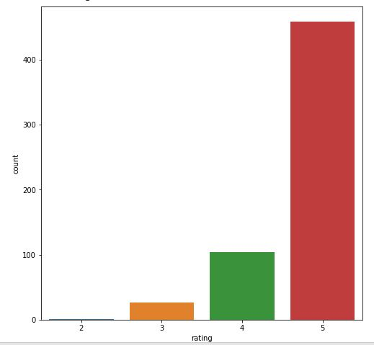
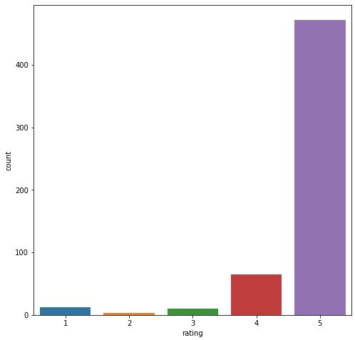
BASIC EDA and WordCLOUD
AT first we performed basic eda on the amazon and flipkart datasets. We saw that out of the purchases made in the respective websites, most purchases have happened in August for amazon and for flipkart it is June. We saw that the mean rating at both these places is almost same(4.7305 and 4.7473 respectively)
Distribution of ratings of amazon vs distribution of ratings of flipkart

Slide 5
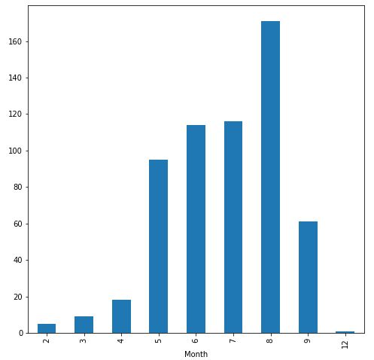
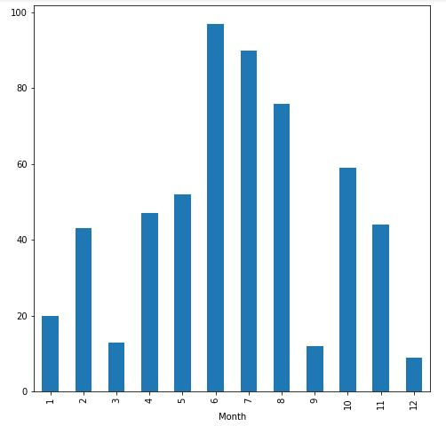
Number of purchases made by month in amazon vs flipkart

Slide 6
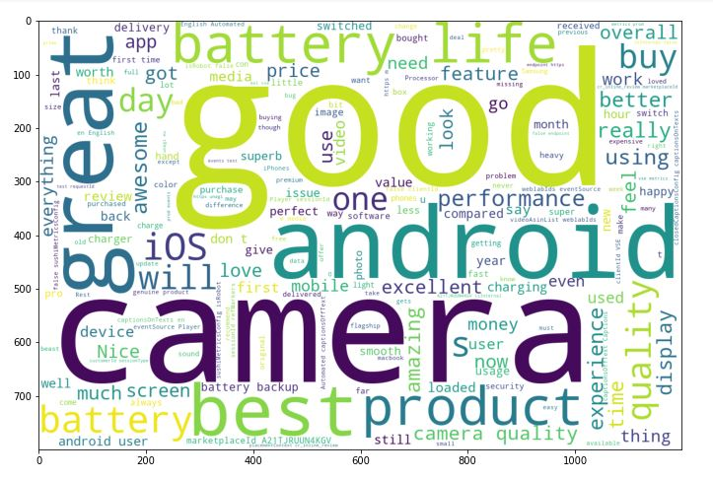
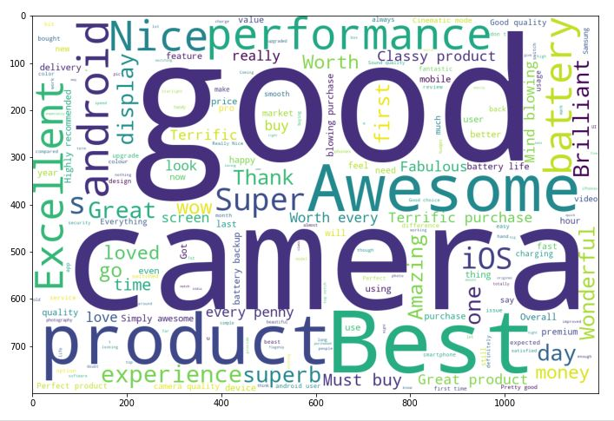
For generating word cloud, we have not considered the normal stopwords as well as the words Flipkart, iPhone, phone, Apple, Amazon.
In a review about iphone, these words being very frequent don’t give us any additional useful information
Wordclouds for amazon and flipkart

Slide 7
We can see that there is not much difference in both the word clouds.
Prominent words(for amazon) - good, camera, battery life, great, android, product, great
Prominent words(for flipkart) –Best, good, camera, awesome, product, battery, superb
We then apply countvectorizer to find the count of prominent words both the set of reviews

Slide 8
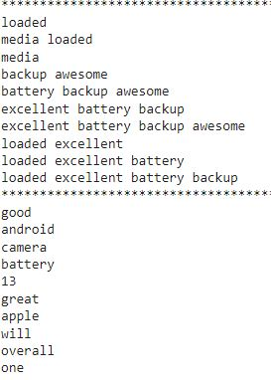
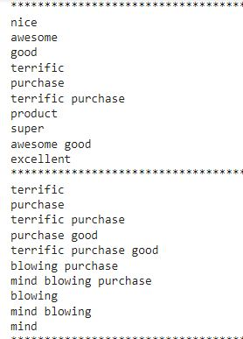
LSA and LDA
LSA-Latent semantic analysis is a linear method that can be used to obtain the latent aspects. These latent aspects can then be used to find common topics among reviews
For generating the aspects via truncated svd we have used represented each review via tfidf vectors of words. The number of aspects that have been chosen for truncated svd is 5.
amazon vs flipkart

Slide 9
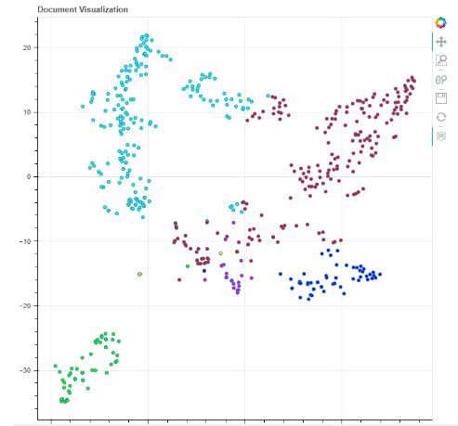
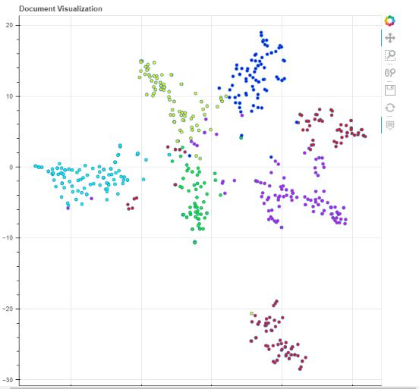
Latent Dirichlet Allocation (LDA) is an example of topic model and is used to classify text in a document to a particular topic. Unlike lsa this is non linear
For lda, we have used the ktrain module in python
We have applied tsne to view clustering of similar reviews
TSNE visualizations for amazon vs flipkart reviews

Slide 10
word2vec
We have used the gensim module to get word embedding of various words based on reviews
Continuous bag of words and skip gram method are 2 methods that can be used for word embeddings
We have then applied pca on the dataset of embedded words and tried to visualize the words good, camera, battery, life, great, android, product, great based on their first 2 principal components
The word embeddings we obtained can be used in other algorithms where we need to represent words as vectors. But in our case since we have less reviews, the embeddings may not be that reliable

Slide 11
Classification and KMEANS
We applied 3 classification algorithms-logistic regression, decision tree regression and support vector regression to predict the reviews. Ml algorithms cannot work with text so we first applied tfidf vectorization of the reviews. It is a sparse matrix, so we then then applied truncated svd (with 200 aspects) to get the review aspect matrix.
We applied similar method with no of aspects=150 but here we applied kmeans clustering for number of clusters 5 to 15. However we failed to get a good elbow point.

Slide 12
conclusion
As we have less number of reviews for only 1 phone, we found no significant difference between in reviews between the 2 websites.
Most of the reviews are overwhelmingly positive in both the websites
They talk about aspects of the phone like battery and camera. They talk about how the phone is a good buy and worth its price
The algorithms like lsa and lda has found topics based on the reviews, but the topics they found are hardly different from each other.
The classification algorithms involving truncated svd gave us relatively better performance
We did not find a good elbow point so we have been unable to find the appropriate number of clusters for kmeans clustering

